Slide 1
Synchronous Counter Operation
Synchronous binary counters
2-bit counter
3-bit counter
4-bit counter
Synchronous BCD decade counter

Slide 2
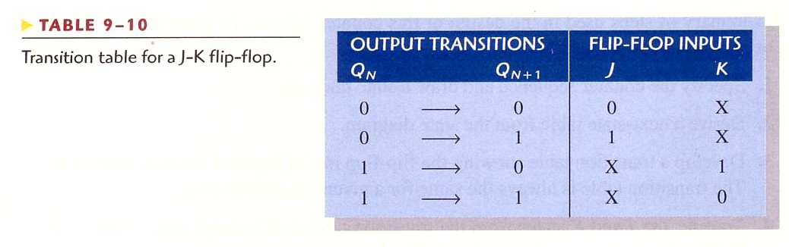

Slide 3
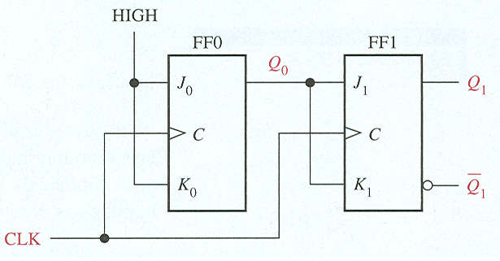
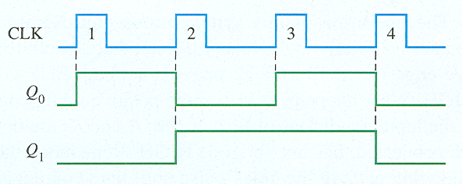
Synchronous Counter Operation
2-bit synchronous binary counter

Slide 4
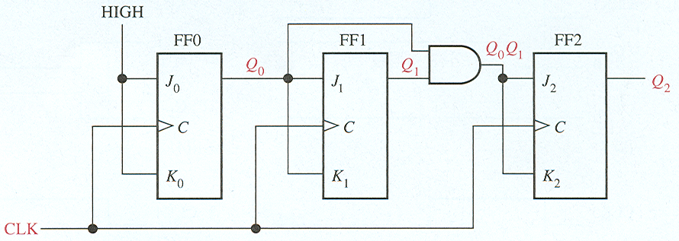
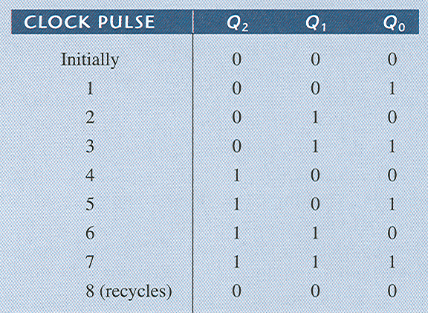
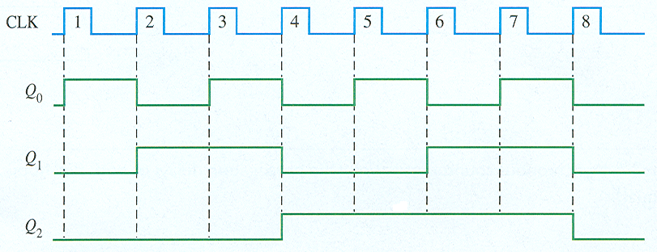
Synchronous Counter Operation
3-bit synchronous binary counter

Slide 5
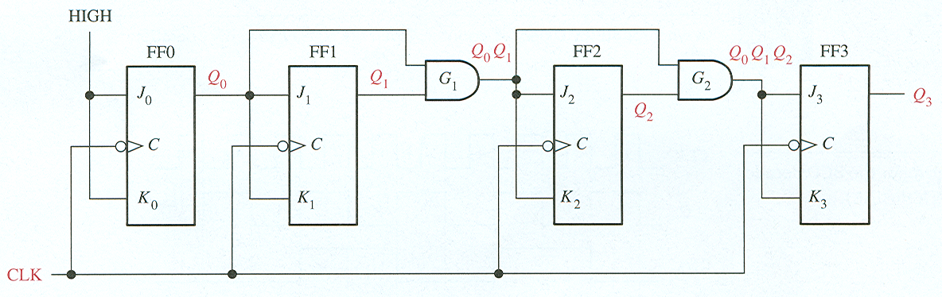
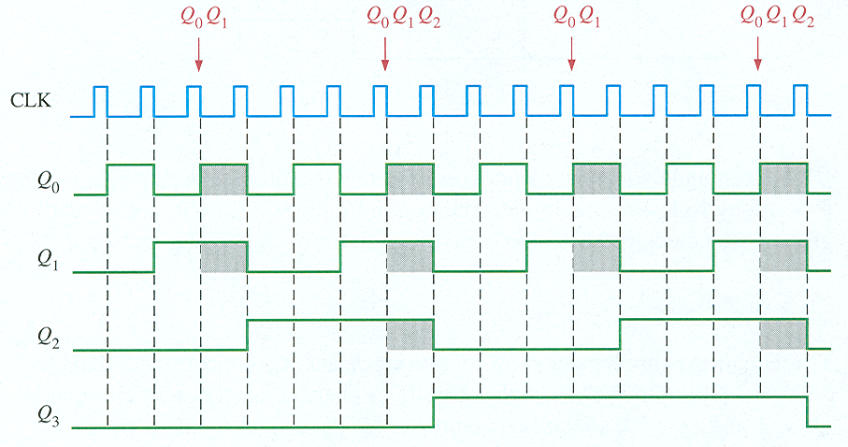
Synchronous Counter Operation
4-bit synchronous binary counter

Slide 6
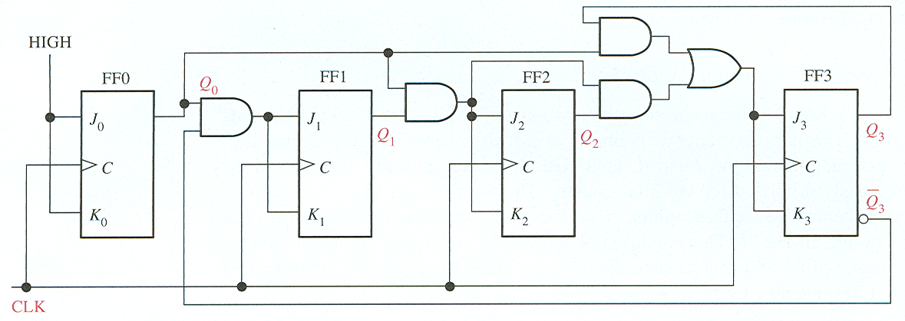
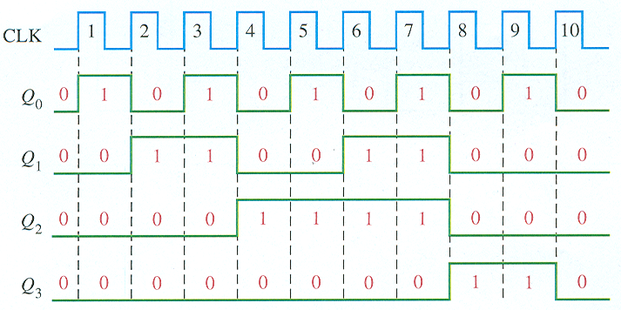
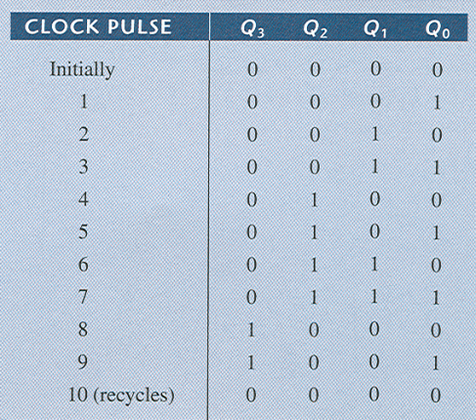
Synchronous BCD decade counter

